Slide 1



2016 - 2017 Beverly Cleary Children’s Choice Nominations

Slide 2
In our 14th year, the Beverly Cleary Children’s Choice Award Committee is proud to announce the following
six 2016-17 BCCCA nominations for the 2016-17 school year:

Slide 3
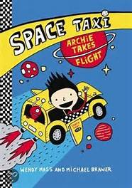
Archie Takes Flight by Wendy Mass
It's not every day a regular kid like Archie gets to wake up at midnight. But today is Take Your Kid to Work Day, and Archie is finally allowed to ride along in his dad's taxi cab. He has been waiting eight years, eight months, and eight days for this moment to arrive. But he's about to discover his dad is no ordinary cab driver...In fact, he drives an intergalactic space taxi! All night long, he shuttles aliens from one corner of the universe to another. And being a space taxi copilot is no easy task: Archie must steer them into wormholes, keep them from crashing into planets, deal with a very unusual cat...and save the universe from an evil mastermind!

Slide 4
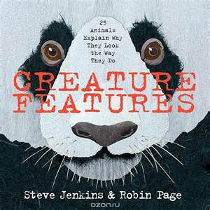
Creature Features: 25 Animals Explain Why They Look the Way They Do
By Steve Jenkins
Let's face it. Even as babies, we humans pay close attention to faces. Observing another person's features and expressions tells us whether they are happy, angry, excited, or sad. And when we look at an animal, it's hard not to imagine that its face is communicating human feelings. This isn't true, of course. Squinty eyes, an upturned mouth, or another odd expression is probably there because, in some way, it helps that animal survive. Packed with many cool facts and visuals on where certain animals live and what they eat, this book captures twenty-five humorous—and very true—explanations of why animals look the way they do in order to exist in this world.

Slide 5
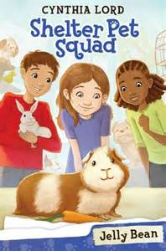
Shelter Pet Squad - Jelly Bean by Cynthia Lord
Suzannah's always wanted a pet of her own, but she lives in an apartment where there are absolutely no pets allowed. What she CAN do is volunteer at a local pet shelter. There, although she's the youngest, Suzannah quickly finds herself making friends with the kids and bonding with the animals. She makes toys and treats for the animals. She feeds the cats and plays with the puppies! Then a girl just her age brings a guinea pig named Jelly Bean to the shelter. Suzannah promises that she'll find the little creature the perfect home. But what if no one wants an abandoned guinea pig?

Slide 6

Lulu and the Rabbit Next Door
By Hilary McKay
When Lulu’s next door neighbor doesn’t seem to be looking after his rabbit properly, Lulu and her cousin Mellie devise a scheme to make him pay more attention to his pet.

Slide 7
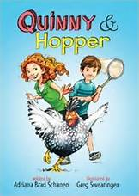
Quinny & Hopper by Adriana Brad Schanen
Quinny has a lot to say. Hopper gets to the point. Quinny has one speed: very, very, extra-very fast. Hopper proceeds with caution. Quinny has big ideas. Hopper has smart solutions. Quinny and Hopper couldn't be more different. They are an unstoppable team. But when summer ends, things suddenly aren't the same. Can Quinny and Hopper stick together in the face of stylish bullies, a killer chicken, and the brand-new Third Grade Rules-especially the one that says they aren't allowed to be friends anymore

Slide 8
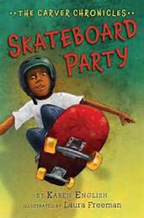
Skateboard Party by Karen English
Richard can't wait to show off his flat-ground Ollies at a friend's birthday party at the skate park, but a note home from his teacher threatens to ruin his plans. He really meant to finish his assignment on howler monkeys, but he just got . . . distracted. If only he could focus on his schoolwork, he wouldn't get into this kind of trouble! Can Richard manage to put off getting the note signed (and facing the consequences) until after the party, or will the deception make things even worse?

Slide 9
To vote for your favorite BCCCA book, read (or listen to)
at least two of the following nominated books...
Remember to vote from March 15 through April 10th
by going onto the BCCCA website
http://ola.memberclicks.net/bccca-how-to-vote

Slide 10
Power Point created by Jennifer Wintersteen
Music,“Sara Lately” copyright Kevin Hamler-Dupras

